Slide 1
Internship Project: Air Quality Data Analysis & Visualization
Harsh Baviskar
Savitribai Phule Pune University
Department of Information Technology

Slide 2
Acknowledgement
I would like to express my gratitude to ShadowFox for giving me the opportunity to present the tasks I have completed during this internship.
I would also like to extend my thanks to my mentor/coordinator, Mr. Aakash and Mr. Hariharan, for guiding me throughout this experience. I acknowledge that the tasks were completed independently by me. Additionally, I utilized certain reference materials for research purposes and used ChatGFT for generating reference ideas.

Slide 3
Technologies & Tools Used
• Python 3.x
• Pandas, NumPy for data processing
• Matplotlib and Plotly for visualization
• Seaborn for heatmaps
• Google Colab for code execution

Slide 4
Key Analysis: Pollutant Statistics (Task 2)
Key pollutants analyzed:
- PM2.5, PM10, NO₂, SO₂, CO, O₃, NH₃
Insights from data:
• Highest average concentration: CO (3814.94 µg/m³)
• PM2.5 exceeded safe limits across all records
• NO₂ and SO₂ showed strong correlation with PM pollutants

Slide 5
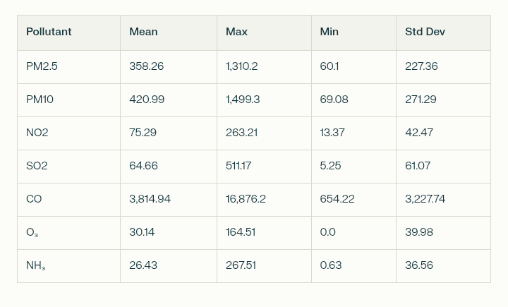
Pollutents data analysis.

Slide 6
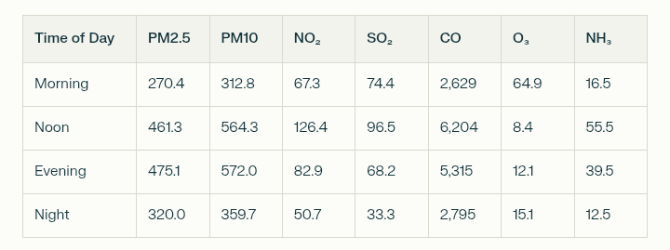
Pollutents spread across various time of the day.

Slide 7
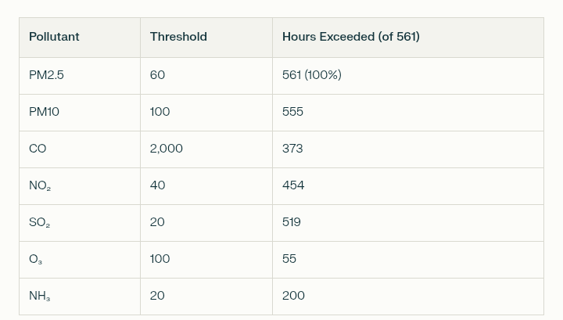
Pollutents and the threshold(healthy amount) and the total hours exceeded over the month.

Slide 8
Worst Pollution Episodes
Jan 13 & Jan 19: Repeatedly among top 5 worst hours for PM2.5, PM10, CO, NO₂, SO₂
CO spike: 16,876 ppb at Jan 13 (likely peak hour traffic/industrial output)
Visual: Line plot of PM2.5 for the month
Summary Comparison and Insights
Delhi's air in January 2023: Hazardous—driven by particulate (PM2.5, PM10) and combustion-related emissions.
Time-of-day effects: Human activity heightens afternoon/evening pollution.
Ozone's role: Inverse/negative correlation, supporting established chemical/photochemical dynamics.
Visualization takeaway: Pairing Python tools (static+interactive) enhances exploratory analysis and communication for real-world issues like AQI.

Slide 9
Visualizations Overview (Task 1)
Visualizations created:
• Time-series line plots of PM2.5 and PM10
• Box plots for seasonal variation
• Heatmap for pollutant correlation
• Interactive pie and bar charts using Plotly and MatplotLib
These visualizations helped identify daily trends, outliers, and relationships among pollutants.

Slide 10
